Slide 1
City Rumble! (Paper Mario)
Christian Stewart & Zach Piekut

Slide 2
No External Libraries!!!

Slide 3
(except for GLUT…)

Slide 4
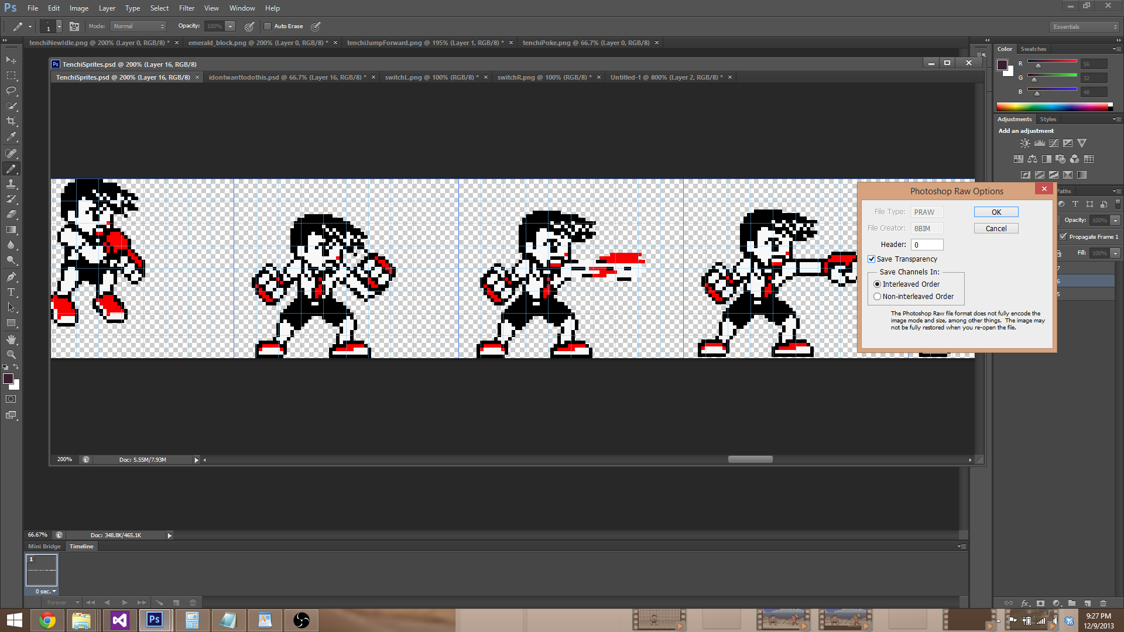
Texture Loading
Loading .RAW files byte by byte
Different loading for RGB/RGBA

Slide 5
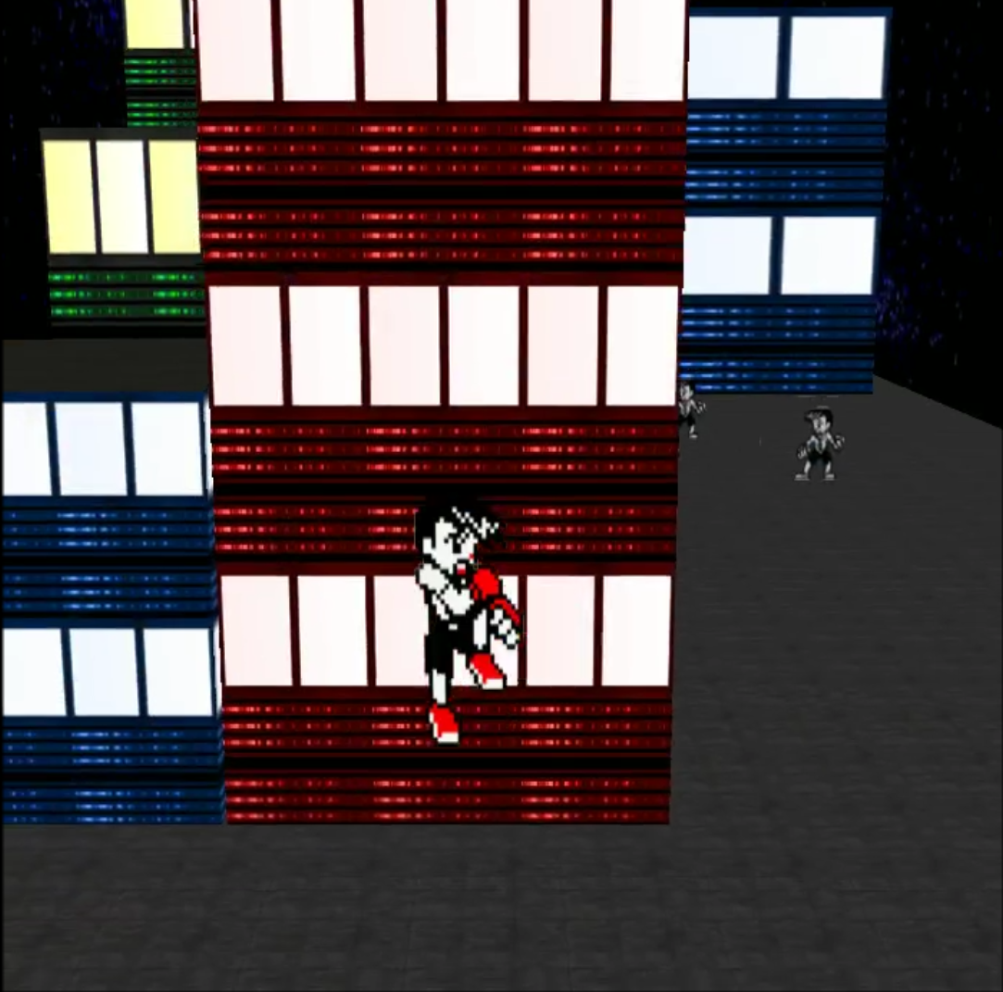
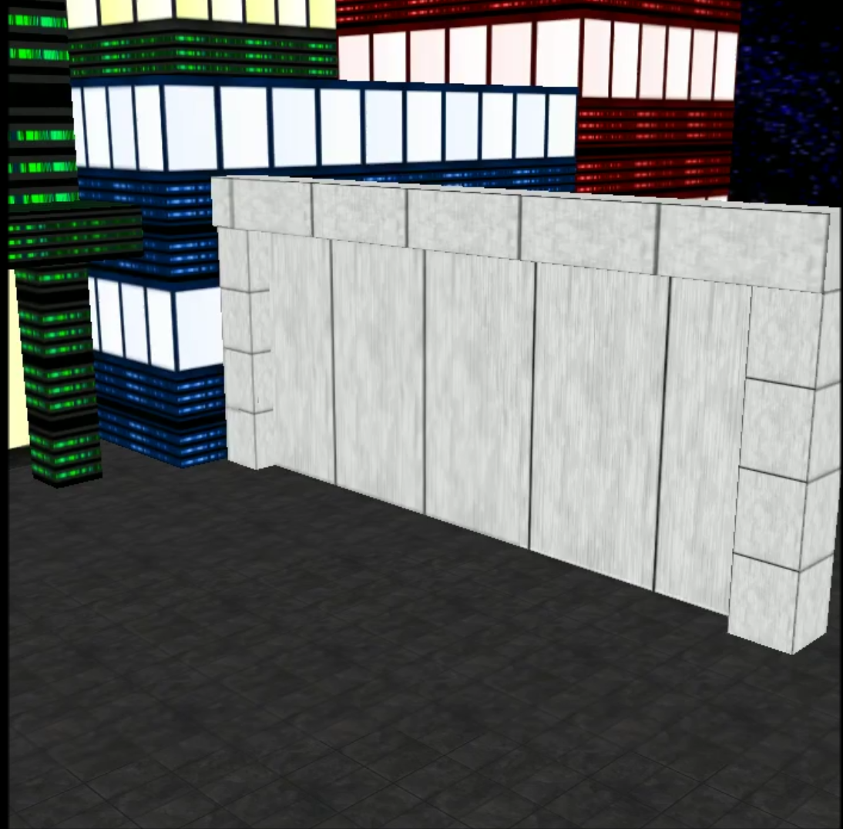
Level Design
Loaded texture are selected and tiled from the spec file
Allows for completely independent level creation

Slide 6
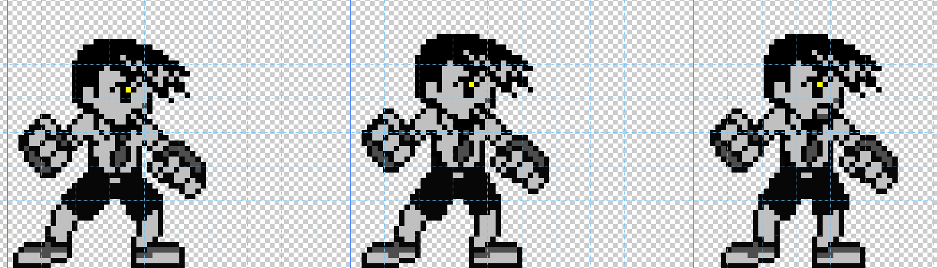
Animation
Animations run on dynamic timer (different frame rates for each animation)
One texture file for all frames

Slide 7
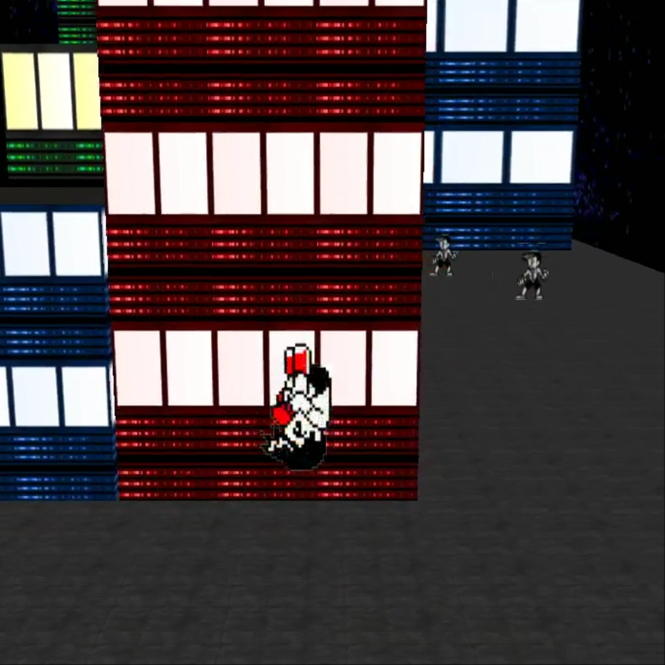
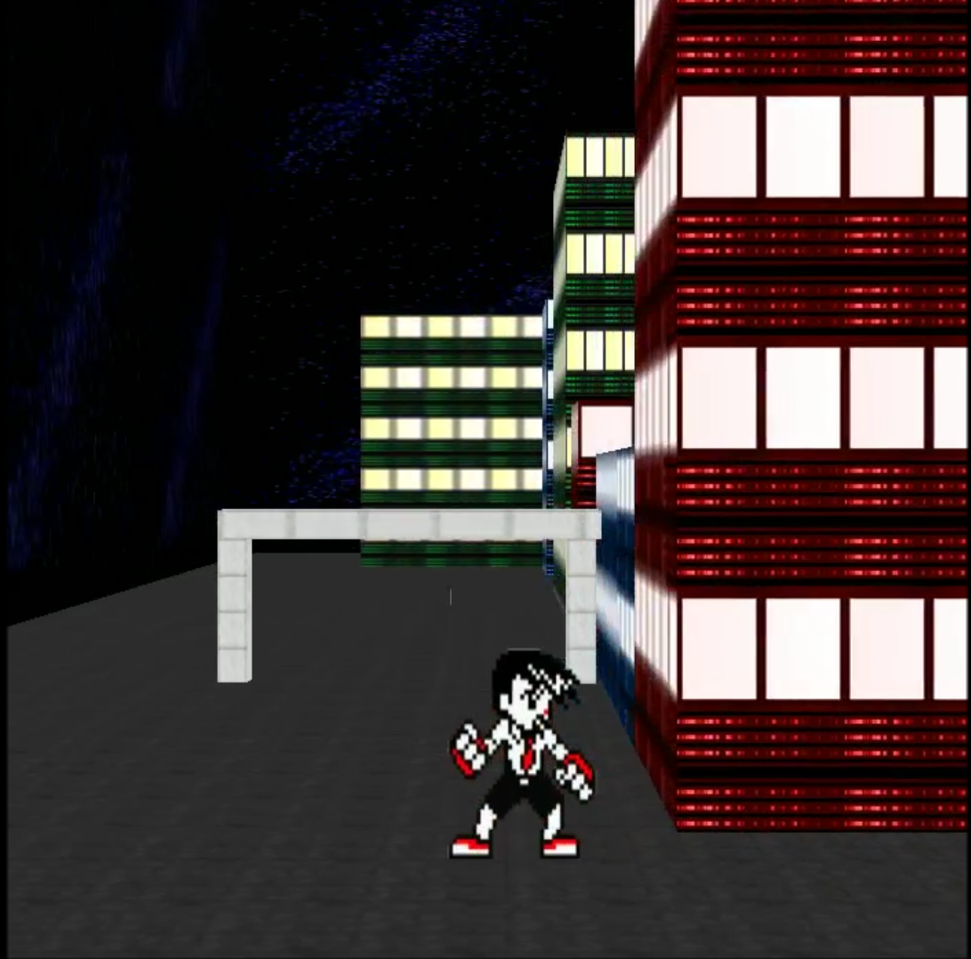
Camera

Slide 8
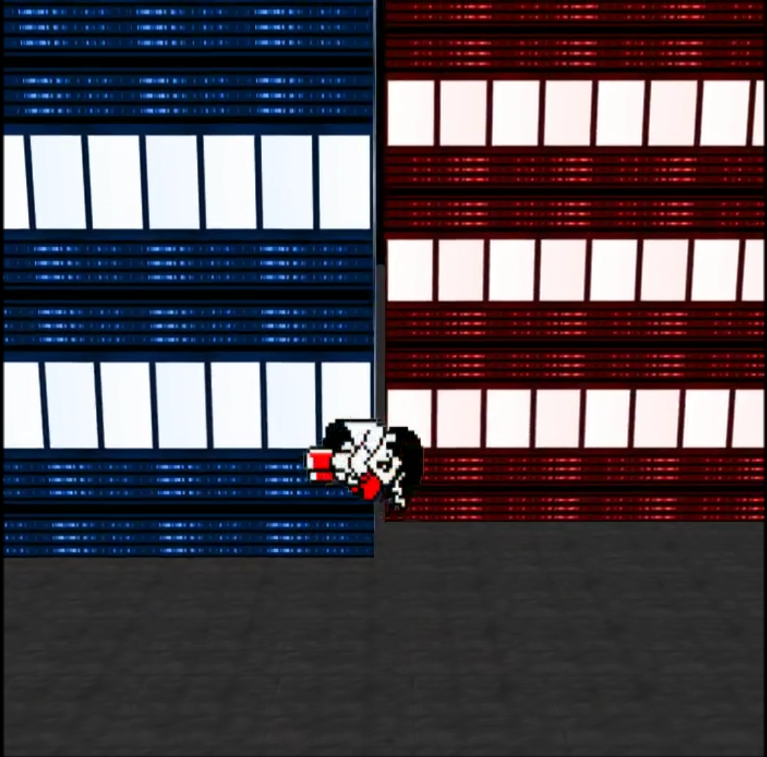
Controls
Double jump allows for direction change
Punching destroys enemies and interacts with objects

Slide 9
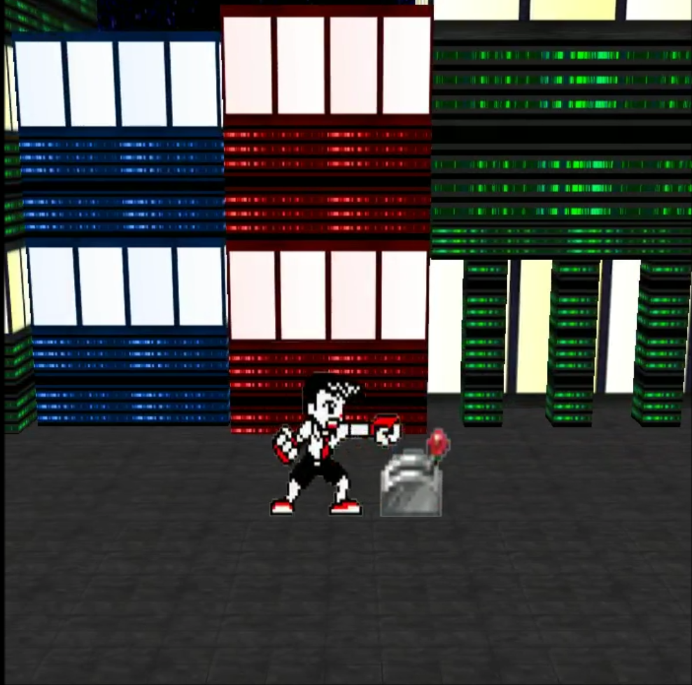
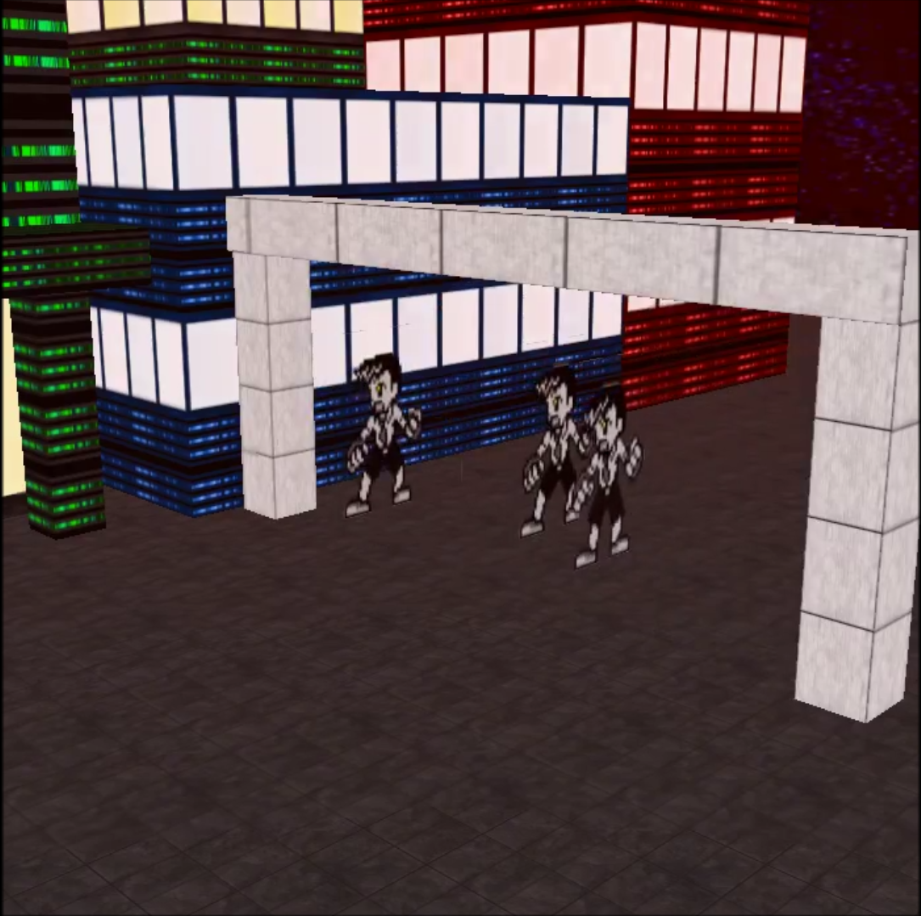
Scripted Events

